Slide 1
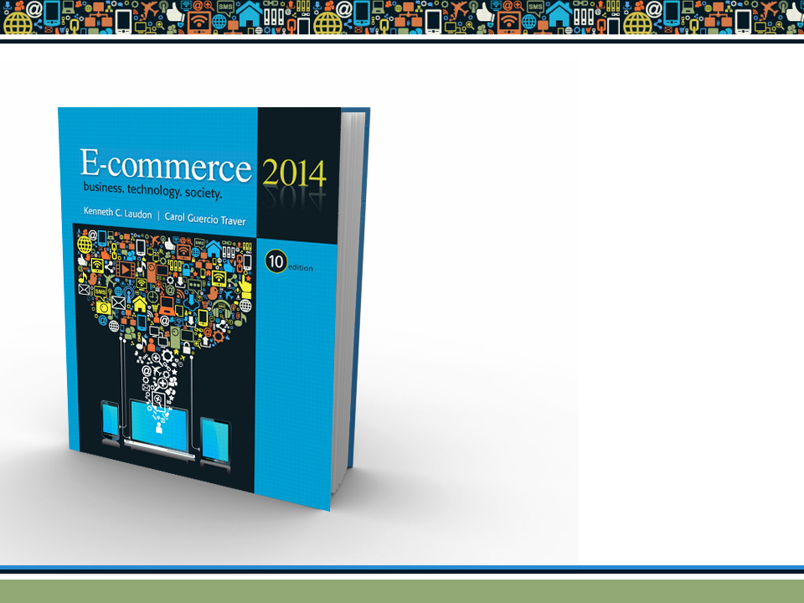
Copyright © 2014 Pearson Education, Inc. Publishing as Prentice Hall

Slide 2

Chapter 2
E-commerce Business Models
and Concepts
Copyright © 2014 Pearson Education, Inc. Publishing as Prentice Hall

Slide 3

Tweet Tweet: Twitter’s Business Model
What characteristics or benchmarks can be used to assess the business value of a company such as Twitter?
Have you used Twitter to communicate with friends or family? What are your thoughts on this service?
What are Twitter’s most important assets?
Which of the various methods described for monetizing Twitter’s assets do you feel might be most successful?
Copyright © 2014 Pearson Education, Inc. Publishing as Prentice Hall
Slide 2-<number>
Notes:
Valuation is always in the eyes of market. It’s transparent for public, opaque for private. High growth companies like Twitter aren’t about revenue per se, other than as an early indicator of potential. 70x EBIT is insane—but its peanuts if you think they’ll be a player in digital ad growth which is being vacuumed up by Google and Facebook.
Wall Street has armies of people to perform this task. Discounting present value of future cash flows further based on value of $$, discounted with performance and market risk, and with potential premium for market dominance which can lead to network effects or acquisition at a premium. So benchmarks are multiple or cash flow, or per user/sub in some businesses—but you need to adjust them.
Why do you ask? If it’s to assess stocks there’s plenty of very informed opinions. If it’s to assess private firms it’s about access to specific information which would lead to the parameters like market growth, multiple, etc

Slide 4
E-commerce Business Models
Business model
  Set of planned activities designed to result in a profit in a marketplace
Business plan
  Describes a firm’s business model
E-commerce business model
  Uses/leverages unique qualities of Internet and Web
Copyright © 2014 Pearson Education, Inc. Publishing as Prentice Hall
Slide 2-<number>
Notes:
a plan for the successful operation of a business, identifying sources of revenue, the intended customer base, products, and details of financing.
A Business Model is a conceptual structure that supports the viability(ability to work successfully.) of a product or company and explains how the company operates, makes money, and how it intends to achieve its goals. All the business processes and policies that a company adopts and follows are part of the business model
A business plan is a written description of your business's future, a document that tells what you plan to do and how you plan to do it. If you jot down a paragraph on the back of an envelope describing your business strategy, you've written a plan, or at least the germ of one. Business plans are inherently strategic.
The e-commerce business model is the conceptual structure of your b2b, b2c, c2c, or c2b business strategy. It includes the purpose and goals of your company and how it intends to achieve them..

Slide 5
Eight Key Elements of a Business Model
Value proposition
Revenue model
Market opportunity
Competitive environment
Competitive advantage
Market strategy
Organizational development
Management team
Copyright © 2014 Pearson Education, Inc. Publishing as Prentice Hall
Slide 2-<number>

Slide 6
1. Value Proposition
“Why should the customer buy from you?”
Successful e-commerce value propositions:
  Personalization/customization
  Reduction of product search, price discovery costs
  Facilitation of transactions by managing product delivery
Copyright © 2014 Pearson Education, Inc. Publishing as Prentice Hall
Slide 2-<number>
Notes:
A value proposition (VP) is a statement of value that meets several criteria. It communicates to customers how your product or service solves a particular problem or improves their lives in a relevant way and explains why customers should buy from your business instead of the competition.
Free shipping.
Return policy.
Reward points.
Product availability.
Customer service
Trust and authenticity

Slide 7
2. Revenue Model
“How will you earn money?”
Major types of revenue models:
  Advertising revenue model
  Subscription revenue model
  Transaction fee revenue model
  Sales revenue model
  Affiliate revenue model
Copyright © 2014 Pearson Education, Inc. Publishing as Prentice Hall
Slide 2-<number>

Slide 8
Foursquare: Check Your Privacy at the Door
What revenue model does Foursquare use? What other revenue models might be appropriate?
Are privacy concerns the only shortcoming of location-based mobile services?
Should business firms be allowed to call cell phones with advertising messages based on location?
Copyright © 2014 Pearson Education, Inc. Publishing as Prentice Hall
Slide 2-<number>
Notes:
a location technology platform dedicated to improving how people move through the real world.

Slide 9
3. Market Opportunity
“What marketspace do you intend to serve and what is its size?”
  Marketspace: Area of actual or potential commercial value in which company intends to operate
  Realistic market opportunity: Defined by revenue potential in each market niche in which company hopes to compete
Market opportunity typically divided into smaller niches
Copyright © 2014 Pearson Education, Inc. Publishing as Prentice Hall
Slide 2-<number>
Notes:
Niche: a comfortable or suitable position in life or employment.

Slide 10
4. Competitive Environment
“Who else occupies your intended marketspace?”
  Other companies selling similar products in the same marketspace
  Includes both direct and indirect competitors
Influenced by:
  Number and size of active competitors
  Each competitor’s market share
  Competitors’ profitability
  Competitors’ pricing
Copyright © 2014 Pearson Education, Inc. Publishing as Prentice Hall
Slide 2-<number>

Slide 11
5. Competitive Advantage
“What special advantages does your firm bring to the marketspace?”
  Is your product superior to or cheaper to produce than your competitors’?
Important concepts:
  Asymmetries
  First-mover advantage, complementary resources
  Unfair competitive advantage
  Leverage
  Perfect markets
Copyright © 2014 Pearson Education, Inc. Publishing as Prentice Hall
Slide 2-<number>
Notes:
An e-business environment results in information asymmetry because buyers cannot physically evaluate the quality of products and easily assess the trustworthiness of sellers. Product and seller quality are communicated through website signals.
First-mover advantage’ refers to the benefit enjoyed by a firm as the consequence of its early entry into a new market. Although the term suggests that early entry is desirable, the advantages of pioneering a new market are often offset by disadvantages. The question of whether a ‘first-mover advantage’ is likely on balance in any specific context depends on the characteristics of the emerging market and the entering firm
Leverage:---the ratio of a company's loan capital (debt) to the value of its ordinary shares (equity); gearing..

Slide 12
6. Market Strategy
“How do you plan to promote your products or services to attract your target audience?”
  Details how a company intends to enter market and attract customers
  Best business concepts will fail if not properly marketed to potential customers
Copyright © 2014 Pearson Education, Inc. Publishing as Prentice Hall
Slide 2-<number>

Slide 13
7. Organizational Development
“What types of organizational structures within the firm are necessary to carry out the business plan?”
Describes how firm will organize work
  Typically, divided into functional departments
  As company grows, hiring moves from generalists to specialists
Copyright © 2014 Pearson Education, Inc. Publishing as Prentice Hall
Slide 2-<number>

Slide 14
8. Management Team
“What kind of backgrounds should the company’s leaders have?”
A strong management team:
  Can make the business model work
  Can give credibility to outside investors
  Has market-specific knowledge
  Has experience in implementing business plans
Copyright © 2014 Pearson Education, Inc. Publishing as Prentice Hall
Slide 2-<number>

Slide 15
Raising Capital
Seed capital:
Seed capital is the initial funding used to begin creating a business or a new product. Obtaining seed capital is the first of the funding stages required for a startup to become an established business.
Traditional sources
  Incubators
  Commercial banks
  Angel investors
  Venture capital firms
  Strategic partners
Crowdfunding
  JOBS Act
Copyright © 2014 Pearson Education, Inc. Publishing as Prentice Hall
Slide 2-<number>
Notes:
Business incubators support the development of start-ups by providing them with advisory and administrative support services. According to the National Business Incubation Association, an incubator's primary objective is to produce successful and financially viable firms that can survive on their own.
An angel investor (also known as a private investor, seed investor or angel funder) is a high net worth individual who provides financial backing for small startups or entrepreneurs, typically in exchange for ownership equity in the company. Often, angel investors are found among an entrepreneur's family and friends.
Venture capital firms: Government, semi-government, or private firm that provides startup or growth equity capital and/or loan capital to promising ventures for returns that are higher than market interest rates.
A strategic partner is an individual or organization with whom you collaborate and share resources. This kind of relationship is a win-win for both parties and can help you take your business to the next level.

Slide 16
Crowdfunding Takes Off
What types of projects and companies might be able to most successfully use crowdfunding?
Are there any negative aspects to crowdfunding?
What obstacles are presented in the use of crowdfunding as a method to fund start-ups?
Copyright © 2014 Pearson Education, Inc. Publishing as Prentice Hall
Slide 2-<number>
Notes:
Crowdfunding is a method of raising capital through the collective effort of friends, family, customers, and individual investors. This approach taps into the collective efforts of a large pool of individuals—primarily online via social media and crowdfunding platforms—and leverages their networks for greater reach and exposure.
if you don’t reach your funding target, any finance that has been pledged will usually be returned to your investors and you will receive nothing
failed projects risk damage to the reputation of your business and people who have pledged money to you
if you haven’t protected your business idea with a patent or copyright, someone may see it on a crowdfunding site and steal your concept
getting the rewards or returns wrong can mean giving away too much of the business to investors
Zero! There are absolutely “no obstacles” as anyone can launch a campaign at any time. However, being successful is an entirely different matter.

Slide 17
Categorizing E-commerce
Business Models
No one correct way
Text categorizes according to:
  E-commerce sector (e.g., B2B)
  E-commerce technology (e.g., m-commerce)
Similar business models appear in more than one sector
Some companies use multiple business models (e.g., eBay)
Copyright © 2014 Pearson Education, Inc. Publishing as Prentice Hall
Slide 2-<number>

Slide 18
B2C Business Models
E-tailer
Community provider (social network)
Content provider
Portal
Transaction broker
Market creator
Service provider
Copyright © 2014 Pearson Education, Inc. Publishing as Prentice Hall
Slide 2-<number>
Notes:
a retail business that sells goods online over the Internet from a website
Portal is a term, generally synonymous with gateway, for a World Wide Web site that is or proposes to be a major starting site for users when they get connected to the Web or that users tend to visit as an anchor site. There are general portals and specialized or niche portals. Some major general portals include Yahoo, Excite, Netscape, Lycos, CNET, Microsoft Network, and America Online's AOL.com.
A transaction broker is a mutual resource in a real estate transaction. Technically, they do not represent either the buyer or the seller. Instead, they can give both parties information and advice.

Slide 19
B2C Models: E-tailer
Online version of traditional retailer
Revenue model: Sales
Variations:
  Virtual merchant
  Bricks-and-clicks
  Catalog merchant
  Manufacturer-direct
Low barriers to entry
Copyright © 2014 Pearson Education, Inc. Publishing as Prentice Hall
Slide 2-<number>
Notes:
A virtual merchant is a website that sells goods and services to the public via online transactions with debit and credit card processing.
Catalog merchant is a term for a form of retailing. The typical merchant sold a wide variety of household and personal products, with many emphasizing jewelry. Unlike a self-serve retail store, most of the items are not displayed; customers selected the products from printed catalogs in the store and filled out an order form.
The term Manufacturer-Direct, also known as Factory-Direct refers to a business model in which the manufacturer sells its goods directly to the end user of the product.

Slide 20
B2C Models: Community Provider
Provide online environment (social network) where people with similar interests can transact, share content, and communicate
  Examples: Facebook, LinkedIn, Twitter, Pinterest
Revenue models:
  Typically hybrid, combining advertising, subscriptions, sales, transaction fees, and so on
Copyright © 2014 Pearson Education, Inc. Publishing as Prentice Hall
Slide 2-<number>

Slide 21
B2C Models: Content Provider
Digital content on the Web:
  News, music, video, text, artwork
Revenue models:
  Subscription; pay per download (micropayment); advertising; affiliate referral
Copyright © 2014 Pearson Education, Inc. Publishing as Prentice Hall
Slide 2-<number>

Slide 22
Battle of the Titans: Music in the Cloud
Have you purchased music online or subscribed to a music service? What was your experience?
What revenue models do cloud music services use?
Do cloud music services provide a clear advantage over download and subscription services?
Of the cloud services from Google, Amazon, and Apple, which would you prefer to use, and why?
Copyright © 2014 Pearson Education, Inc. Publishing as Prentice Hall
Slide 2-<number>

Slide 23
B2C Business Models: Portal
Search plus an integrated package of content and services
Revenue models:
  Advertising, referral fees, transaction fees, subscriptions
Variations:
  Horizontal/general
  Vertical/specialized (vortal)
  Search
Copyright © 2014 Pearson Education, Inc. Publishing as Prentice Hall
Slide 2-<number>
Notes:
Generalized portals rely heavily on mass appeal and huge volumes of traffic. The most obvious examples are search engines like Google, Bing, and DuckDuckGo. ISPs like AOL generate traffic through content and services.
Vortals or specialized portals are based on an area of interest or industry-service. These portals keep to specific content to ensure continued interest from a group of visitors. Although volume is of importance, it is less so than for Generalized portals.
Profile or personalized portals enable visitors to customize the site based on their interest and requirements

Slide 24
B2C Models: Transaction Broker
Process online transactions for consumers
  Primary value proposition—saving time and money
Revenue model:
  Transaction fees
Industries using this model:
  Financial services
  Travel services
  Job placement services
Copyright © 2014 Pearson Education, Inc. Publishing as Prentice Hall
Slide 2-<number>

Slide 25
B2C Models: Market Creator
Create digital environment where buyers and sellers can meet and transact
Examples:
  Priceline
  eBay
Revenue model: Transaction fees, fees to merchants for access
Copyright © 2014 Pearson Education, Inc. Publishing as Prentice Hall
Slide 2-<number>

Slide 26
B2C Models: Service Provider
Online services
  Example: Google—Google Maps, Gmail, and so on
Value proposition
  Valuable, convenient, time-saving, low-cost alternatives to traditional service providers
Revenue models:
  Sales of services, subscription fees, advertising, sales of marketing data
Copyright © 2014 Pearson Education, Inc. Publishing as Prentice Hall
Slide 2-<number>
Notes:
Value proposition:- (in marketing) an innovation, service, or feature intended to make a company or product attractive to customers.

Slide 27
B2B Business Models
Net marketplaces
  E-distributor
  E-procurement
  Exchange
  Industry consortium
Private industrial network
Copyright © 2014 Pearson Education, Inc. Publishing as Prentice Hall
Slide 2-<number>
Notes:
An industry consortium is a group that involves representatives from several different companies. Usually, consortia are composed of companies from within a single industry.

Slide 28
B2B Models: E-distributor
Version of retail and wholesale store, MRO goods, and indirect goods
Owned by one company seeking to serve many customers
Revenue model: Sales of goods
Example: Grainger.com
Copyright © 2014 Pearson Education, Inc. Publishing as Prentice Hall
Slide 2-<number>
Notes:
MRO( maintenance, repair and operation)

Slide 29
B2B Models: E-procurement
Creates digital markets where participants transact for indirect goods
  B2B service providers, application service providers (ASPs)
Revenue model:
  Service fees, supply-chain management, fulfillment services
Example: Ariba
Copyright © 2014 Pearson Education, Inc. Publishing as Prentice Hall
Slide 2-<number>
Notes:
Ariba Network is where millions of collaborative companies will transact $3 trillion in business commerce this year, facilitating data-driven insights, conscious purchase decisions, and simple user experiences to control costs, manage spend, and minimize risk.

Slide 30
B2B Models: Exchanges
Independently owned vertical digital marketplace for direct inputs
Revenue model: Transaction, commission fees
Create powerful competition between suppliers
Tend to force suppliers into powerful price competition; number of exchanges has dropped dramatically
Copyright © 2014 Pearson Education, Inc. Publishing as Prentice Hall
Slide 2-<number>
Notes:
vertical e-commerce players are specialists. So an online retailer that only sells baby products is a vertical e-commerce business, so is one that only sells shoes.

Slide 31
B2B Models: Industry Consortia
Industry-owned vertical digital marketplace open to select suppliers
More successful than exchanges
  Sponsored by powerful industry players
  Strengthen traditional purchasing behavior
Revenue model: Transaction, commission fees
Example: Exostar
Copyright © 2014 Pearson Education, Inc. Publishing as Prentice Hall
Slide 2-<number>
Notes:
An industry consortium is a group that involves representatives from several different companies. Usually, consortia are composed of companies from within a single industry. For example, the SOI Industry Consortium is a group of electronics companies.

Slide 32
Private Industrial Networks
Digital network used to coordinate among firms engaged in business together
Typically evolve out of company’s internal enterprise system
Example: Walmart’s network for suppliers
Cost absorbed by network owner and recovered through production and distribution efficiencies
Copyright © 2014 Pearson Education, Inc. Publishing as Prentice Hall
Slide 2-<number>

Slide 33
E-commerce Enablers:
The Gold Rush Model
E-commerce infrastructure companies have profited the most:
  Hardware, software, networking, security
  E-commerce software systems, payment systems
  Media solutions, performance enhancement
  CRM software
  Databases
  Hosting services, and so on
Copyright © 2014 Pearson Education, Inc. Publishing as Prentice Hall
Slide 2-<number>

Slide 34
How E-commerce Changes Business
E-commerce changes industry structure by changing:
  Rivalry among existing competitors
  Barriers to entry
  Threat of new substitute products
  Strength of suppliers
  Bargaining power of buyers
Copyright © 2014 Pearson Education, Inc. Publishing as Prentice Hall
Slide 2-<number>

Slide 35
Industry Value Chains
Set of activities performed by suppliers, manufacturers, transporters, distributors, and retailers that transform raw inputs into final products and services
Internet reduces cost of information and other transactional costs
Leads to greater operational efficiencies, lowering cost, prices, adding value for customers
Copyright © 2014 Pearson Education, Inc. Publishing as Prentice Hall
Slide 2-<number>

Slide 36
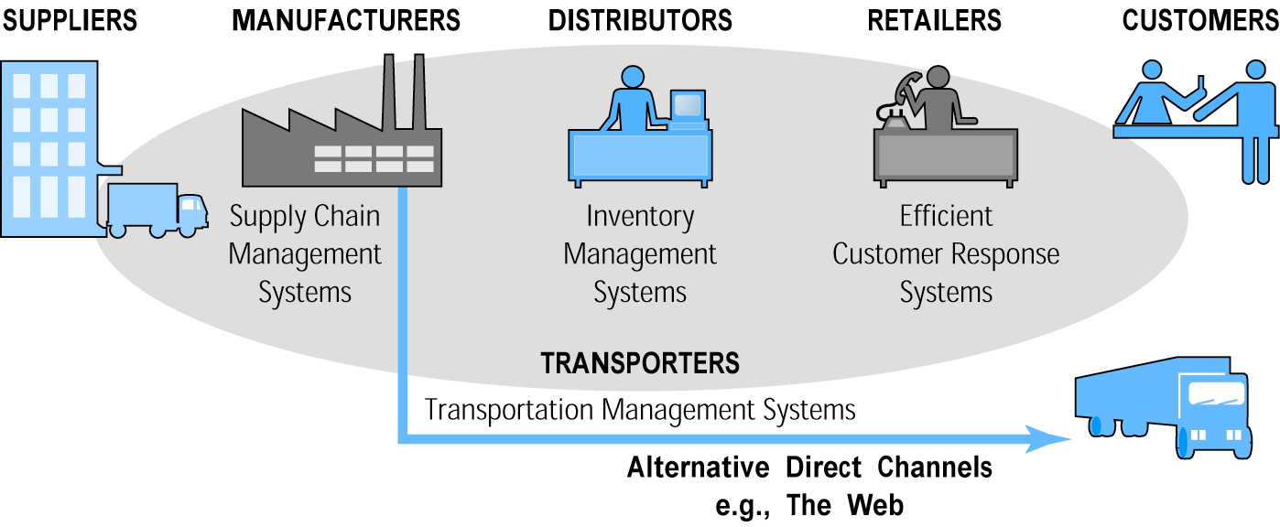
E-commerce and Industry Value Chains
Figure 2.5, Page 90
Copyright © 2014 Pearson Education, Inc. Publishing as Prentice Hall
Slide 2-<number>

Slide 37
Firm Value Chains
Activities that a firm engages in to create final products from raw inputs
Each step adds value
Effect of Internet:
  Increases operational efficiency
  Enables product differentiation
  Enables precise coordination of steps in chain
Copyright © 2014 Pearson Education, Inc. Publishing as Prentice Hall
Slide 2-<number>
Notes:
A firm value chain is the set of activities
a firm engages in to create final products from raw inputs. Each step in the process of production adds value to the final product. In addition, firms develop support activities that coordinate the production process and contribute to overall operational efficiency.

Slide 38
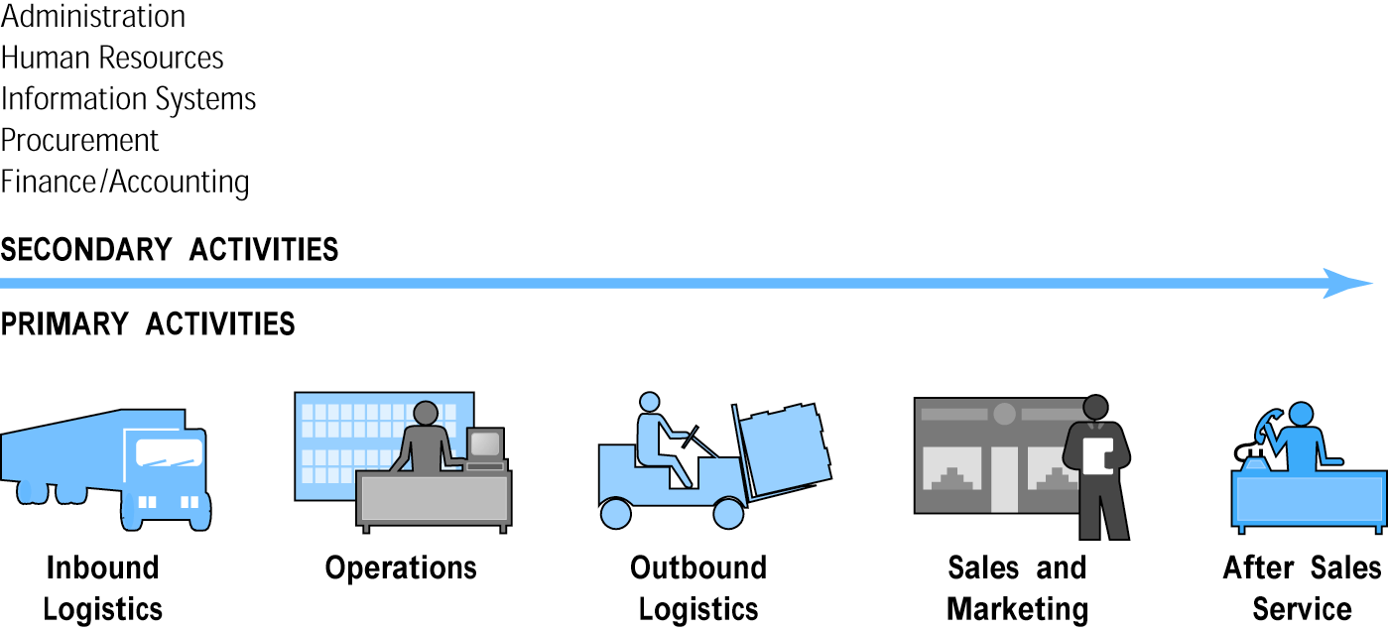
E-commerce and Firm Value Chains
Figure 2.6, Page 91
Copyright © 2014 Pearson Education, Inc. Publishing as Prentice Hall
Slide 2-<number>
Notes:
Every firm can be characterized by a set of value-adding primary and secondary activities performed by a variety of actors in the firm. A simple firm value chain performs five primary value-adding steps: inbound logistics, operations, outbound logistics, sales and marketing, and after sales service.

Slide 39
Firm Value Webs
Networked business ecosystem
Uses Internet technology to coordinate the value chains of business partners
Coordinates a firm’s suppliers with its own production needs using an Internet-based supply chain management system
Copyright © 2014 Pearson Education, Inc. Publishing as Prentice Hall
Slide 2-<number>
Notes:
value web is a networked business ecosystem that uses e-commerce technology to coordinate the value chains of business partners within an industry, or at the first level, to coordinate the value chains of a group of firms.

Slide 40
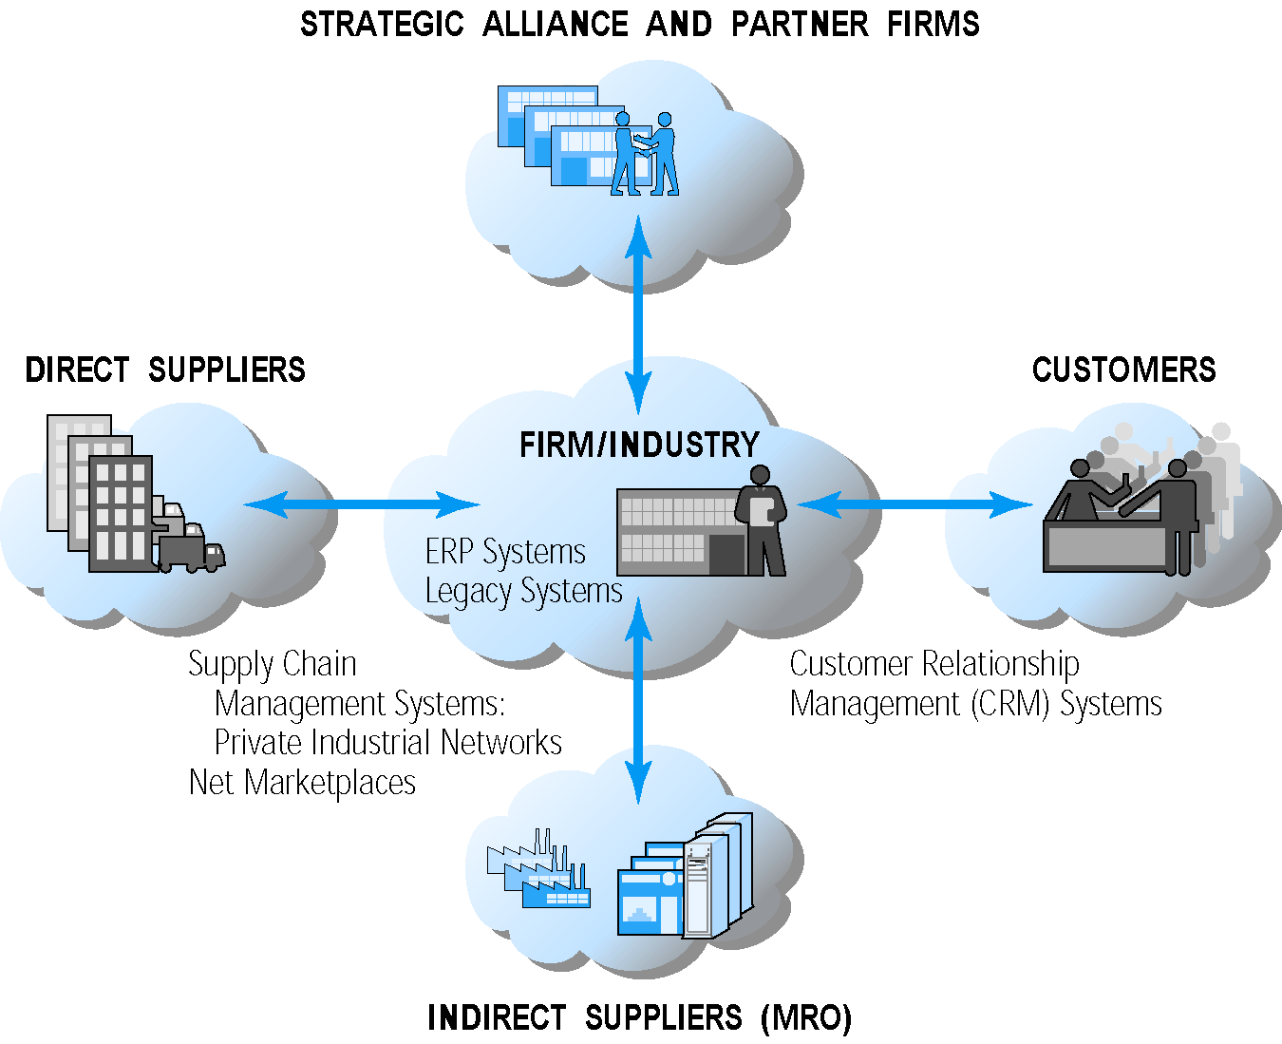
Internet-enabled Value Web
Figure 2.7, Page 92
Copyright © 2014 Pearson Education, Inc. Publishing as Prentice Hall
Slide 2-<number>

Slide 41
Business Strategy
Plan for achieving superior long-term returns on capital invested: that is, profit
Five generic strategies
  Product/service differentiation
  Cost competition
  Scope
  Focus
  Customer intimacy
Copyright © 2014 Pearson Education, Inc. Publishing as Prentice Hall
Slide 2-<number>
Notes:
Differentiation refers to all the ways producers can make their products or services unique and distinguish them from those of competitors.

Slide 42
Copyright © 2014 Pearson Education, Inc. Publishing as Prentice Hall
Slide 2-<number>

